Slide 1
Autonomous Flag Finder
Burnout Squad
Jeremiah McCutcheon: Project Manager
David Koblah: Hardware Design
Michael Bates: Software Design

Slide 2
System Description
This system is an autonomous robot designed to locate, identify and retrieve flags inside a room or maze.
It will utilize a camera and proximity sensors to navigate its environment.
The camera will wirelessly communicate with a computer in order to identify flags and retrieve them.
A microcontroller will control the movement of the tank, proximity sensors and servo motors to rotate the camera or retrieve the flags.
David Koblah

Slide 3
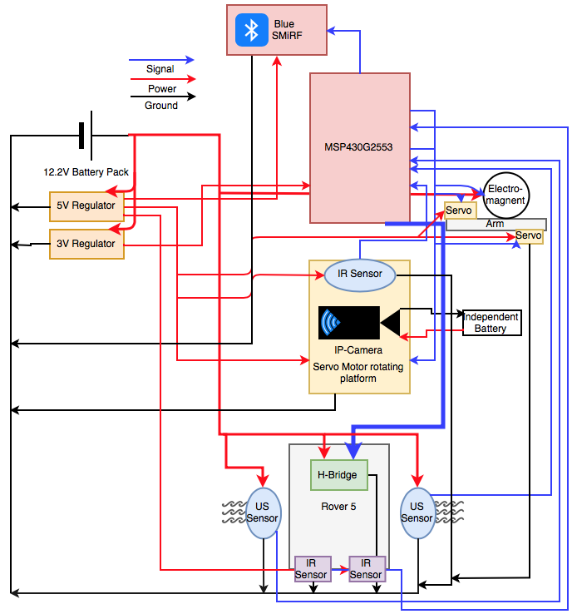
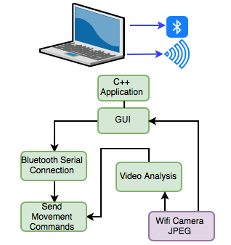
System Diagram
David Koblah

Slide 4
Division of labor
Jeremiah: Bluetooth Serial Communication Interface with Mac, Video Camera Interface with Mac, Image Processing
David: BlueSMiRF receiving communication, Servo arm and Electromagnet interface, Flag Collection
Michael: Analog IR sensor implementation, Autonomous Navigation, MSP430 Code Interface, PCB, Budget
Michael Bates

Slide 5
Safety Concerns
Our primary safety concern this week has been managing the 9.6V battery to avoid any fires and over volting microcontroller circuits. We may also add a warning signal to our design to prevent fellow lab users from running into the rover.
Making sure not to connect to TTU with lab router.
Wearing appropriate Personal Protective Equipment
Pants
Closed Toed Shoes
Safety Glasses
David Koblah

Slide 6
Last Week’s Deliverables
Jeremiah
Complete Blob Detection❌
Integrate RSSI Signal ✅
Write ‘Blob Mode’ Code❌
(New) Work on RTS/CTS With BlueSMiRF✅
David
Build Flags For Blob Testing✅
Integrate Electromagnet into Robot Arm✅
Sample and Integrate RTS/CTS Into Flag Finder System✅
Michael
Add ADC10 Code for Analog IR Distance Sensors ✅
Run Tests with Analog IR Distance Sensors ✅
Create Distance Values Datasheet For Sensor Readings ✅
Michael Bates

Slide 7
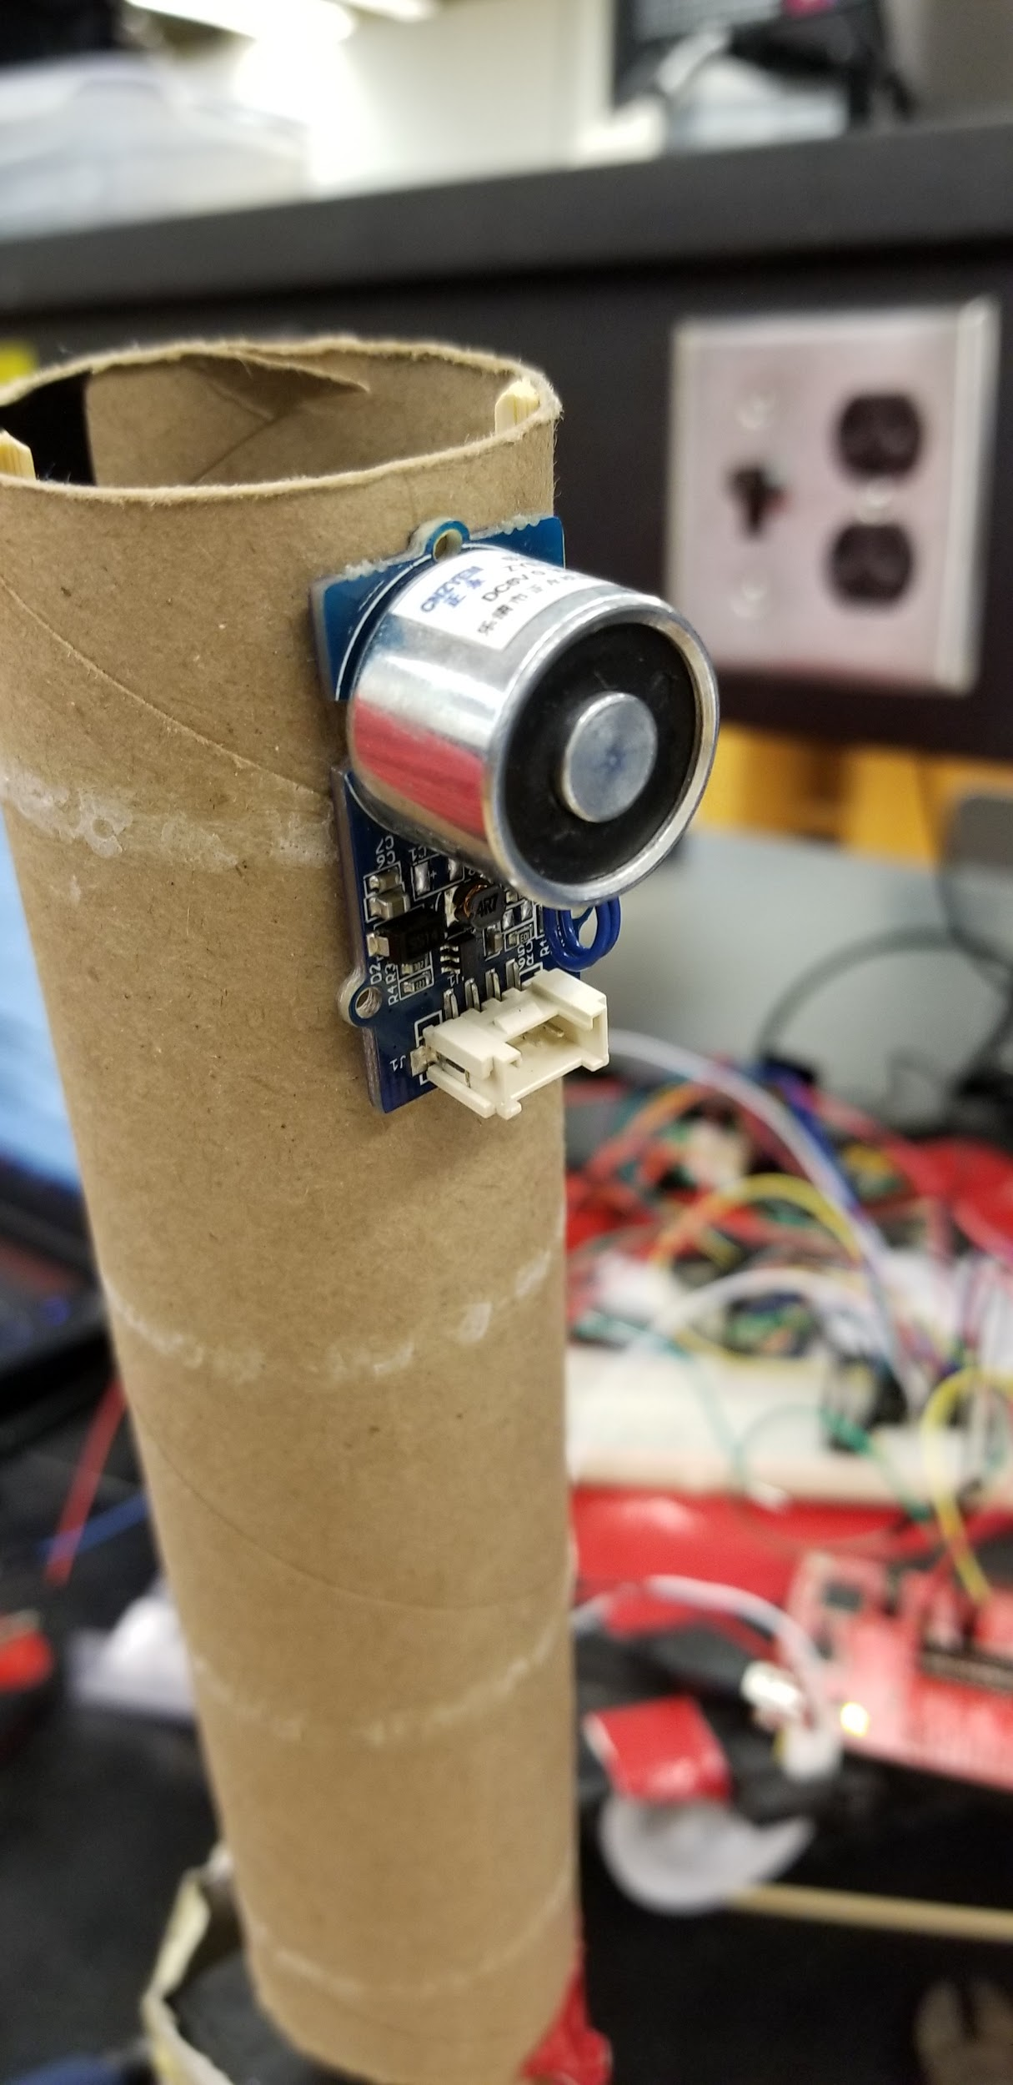
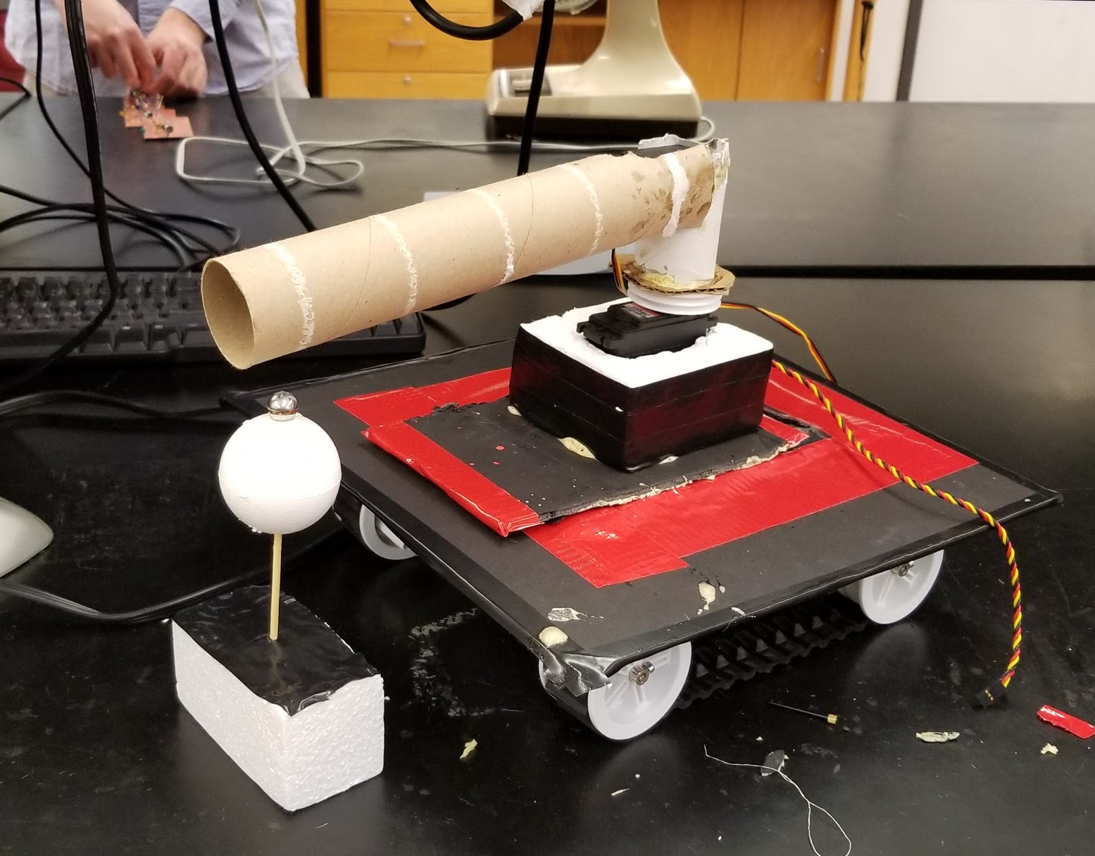
Rover With Robot Arm and Constructed Flag
Attached ElectroMagnet
David Koblah

Slide 8
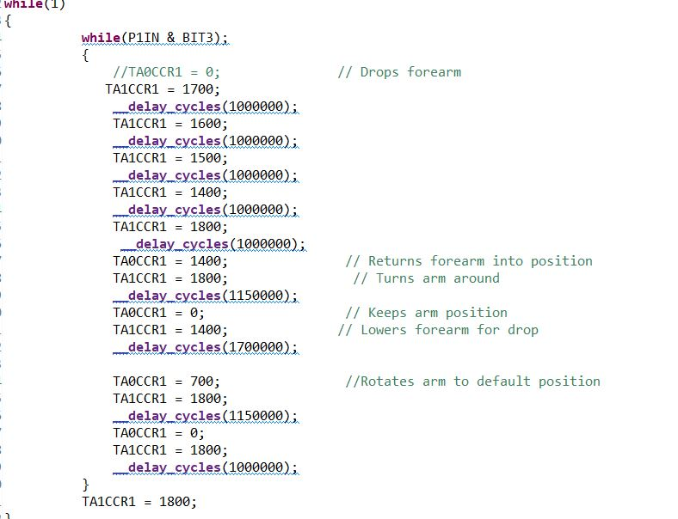
Refinalized Robot Arm Sequence
Gradually drops arm to allow magnet to grab flag
David Koblah

Slide 9
Arm and Flag Demonstration Video
David Koblah

Slide 10
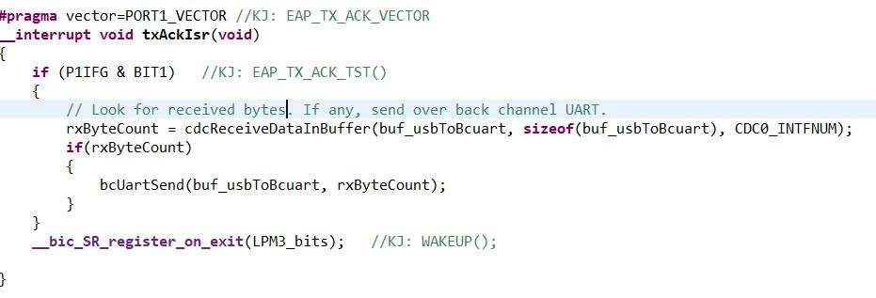
Request-To -Send & Clear-To-Send
Can be used with any pin on MCU.
Still testing.
Planning to shelve until integration phase.
Will only increase efficiency of robot
David Koblah

Slide 11
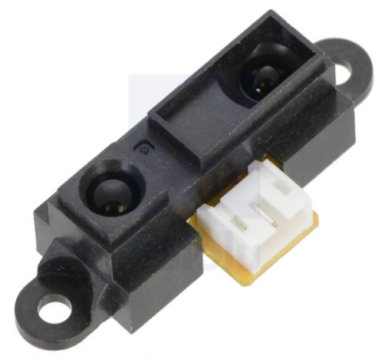
Pololu Sharp GP2Y0A21YK0F Analog Distance Sensor 10-80cm
Specifications:
Operating Voltage: 4.5V to 5.5V
Average Current Consumption: 30 mA
Output Voltage: 1.65V to 2.15 (1.9V Typical)
Distance Measuring Range: 4” to 32”
Pololu.com [1]
Michael Bates

Slide 12
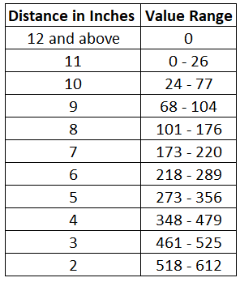
Distance Values
Michael Bates
Excel [2]

Slide 13
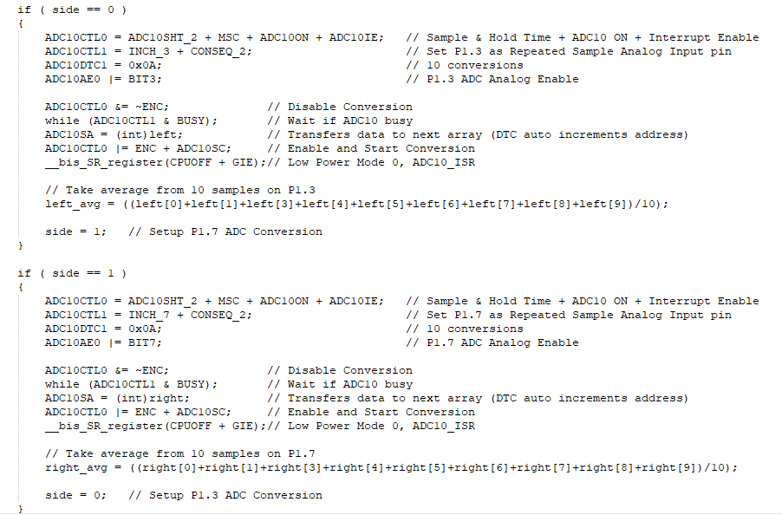
Reading 2 Analog Pins
Analog-To-Digital Conversion for 2 Sensors [3]
Michael Bates

Slide 14
Distance Readings and Movement Demonstration Videos
Michael Bates

Slide 15
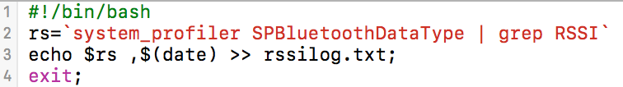
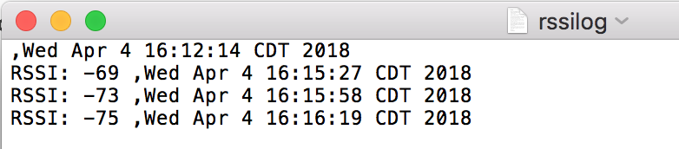
Importing RSSI
Useless for C++
Query system for Bluetooth RSSI
Save to RSSILog
Jeremiah McCutcheon
RSSI System Query [4]

Slide 16
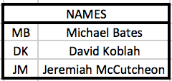
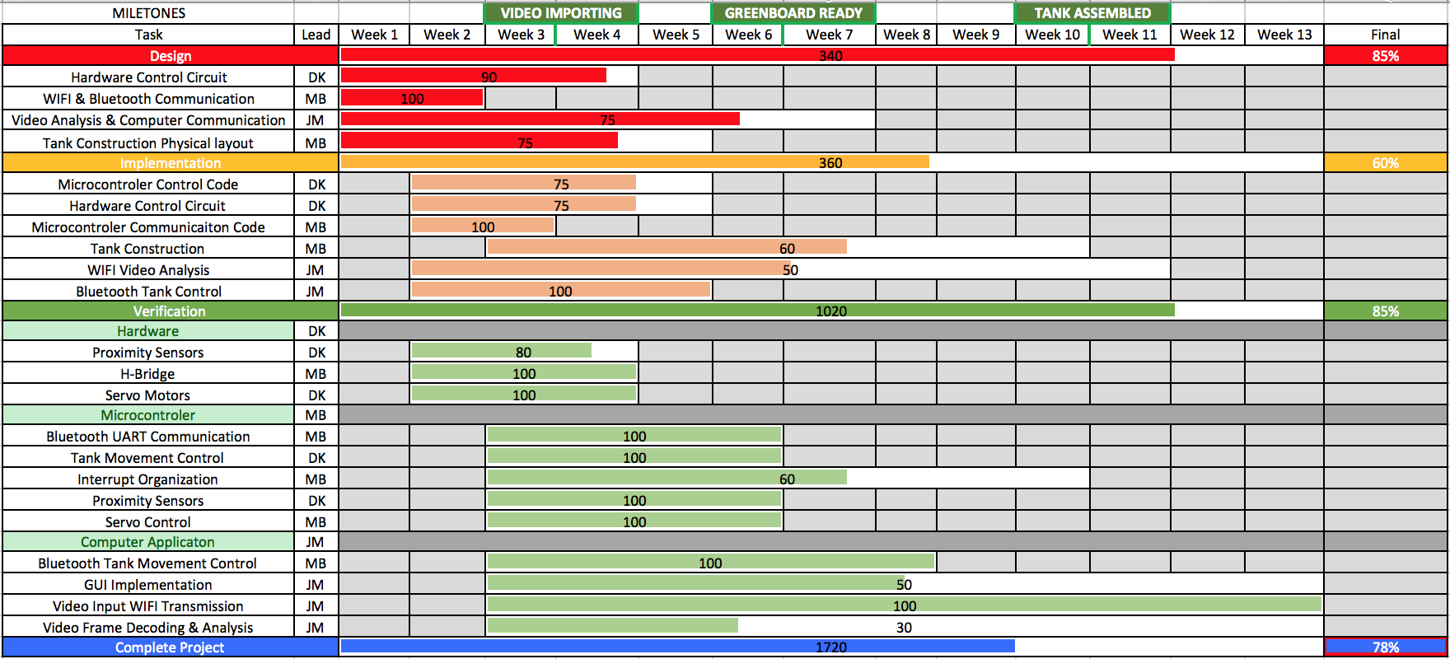
Gantt Chart
Jeremiah McCutcheon

Slide 17
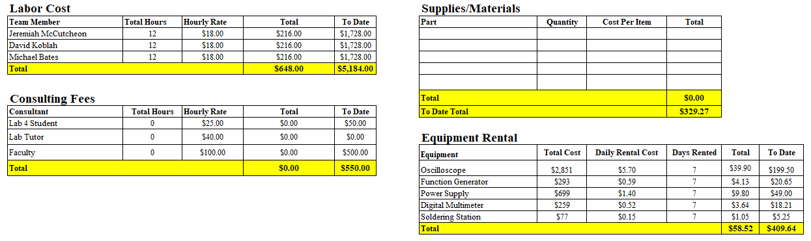
Budget
Michael Bates

Slide 18
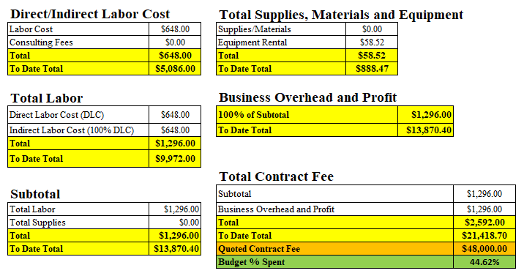
Budget Continued
Michael Bates

Slide 19
Next Week’s Deliverables
Jeremiah
Complete Blob Detection
Write ‘Blob Mode’ Code
Michael & David
Interface Servo Arm and Electromagnet Code with Sensor Navigation Code
Run Tests with Sensor Movement and Servo Arm
Finalize power distribution for the entire system
David Koblah

Slide 20
References
[1] Pololu, Sharp GP2Y0A21YK0F Analog Distance Sensor 10-80cm, https://www.pololu.com/product/136
[2] Microsoft Excel
[3]Analog-to-Digital Conversion for 2 Sensors, Ben Cadieux, Lee Denaro, Paul Ellsworth, Adam Robert, http://myweb.wit.edu/johnsont/classes/462/adc%20for%202%20sensors.htm
[4] https://superuser.com/questions/1219972/osx-lion-bluetooth-rssi-monitor
Michael Bates

Slide 21
Questions?

